Slide 1
EXPLORATORY DATA ANALYSIS INDIAN PREMIER LEAGUE
BY:-RITURAJ SHARMA

Slide 2
IPL OVERVIEW
FIRST EDITION
The Indian Premier League (IPL) premier Twenty20 cricket league in India. Renowned for its high-energy matches and star-studded teams representing cities, the IPL has become a global cricketing phenomenon. With innovative formats and top international players, it blends entertainment and competition, captivating a massive fan base. The IPL has redefined modern cricket, elevating it beyond a sport to a cultural spectacle.
2008
FORMAT
Twenty20
NUMBER OF TEAMS
TEN ( 10 )
ADMINISTRATOR
BCCI
( Board of Control for Cricket in India )
HEADQUARTERS
Cricket Centre, Churchgate,
Mumbai, Maharashtra

Slide 3
Queries
Total Runs Scored by Each Team
Top 10 Batsmen with Highest Runs
Dismissal Type Distribution
Which bowling team has conceded the most extra runs in the IPL?
Total Runs Scored by Each Team
Top 10 Bowlers with Most Wickets
Number of Sixes Hit by Each Team
Most Successful Chasing Team
Most Successful Defending Team
Most Wickets Taken in Death Overs (Overs 16-20)

Slide 4
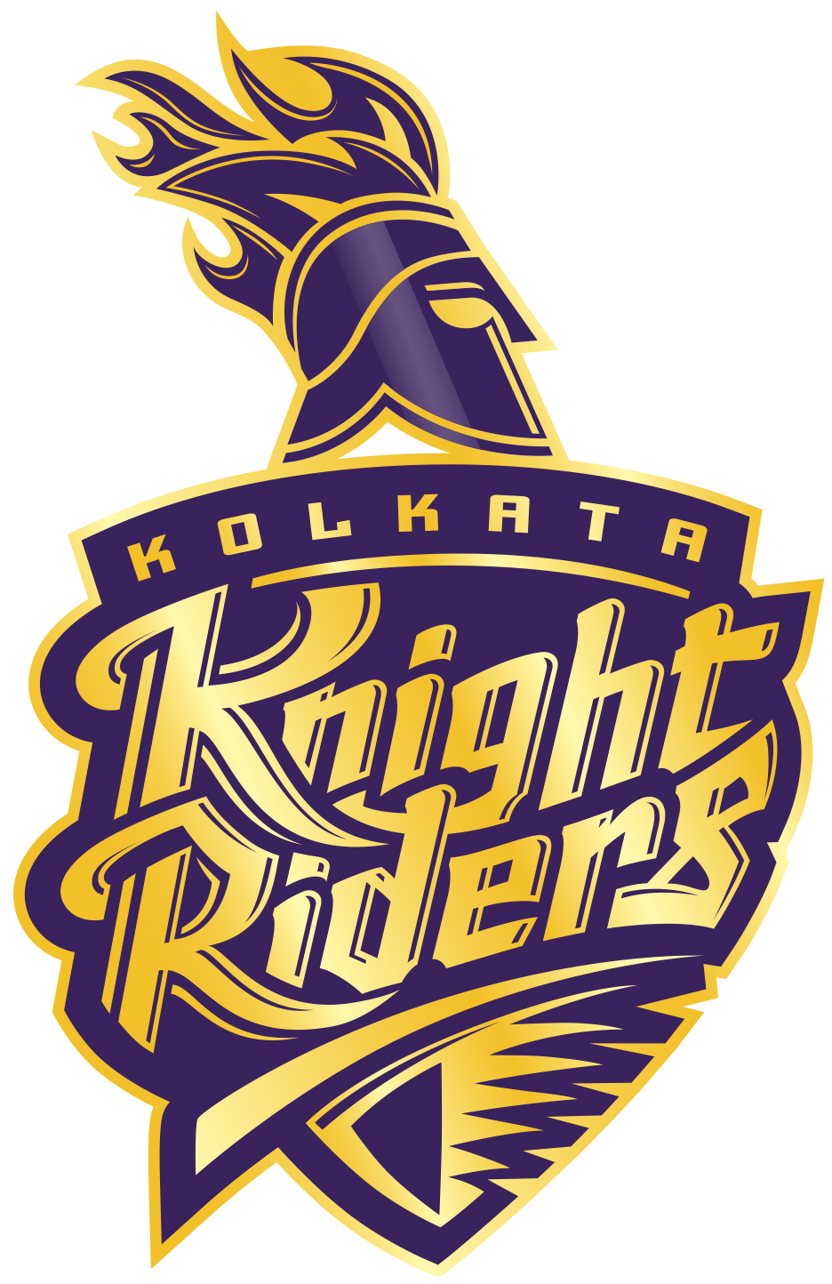
TEAM PLAYING
CHENNAI SUPER KINGS
MUMBAI INDIANS
DELHI CAPITALS
PUNJAB KINGS
GUJRAT TITANS
RAJASTHAN ROYALS
ROYAL CHALLENGERS BANGALORE
KOLKATA KNIGHT RIDERS
LUCKNOW SUPER GIANTS
SUNRISERS HYDERABAD

Slide 5
IPL 2024 VENUE
Arun Jaitley Stadium
(Delhi)
Capacity: 35,200
Edan Gardens
(Kolkata)
Capacity: 68,000
Narendra Modi Stadium
(Ahmedabad)
Capacity: 132,000
M A Chidambaram Stadium
Wankhede Stadium
(Chennai)
(Mumbai)
Capacity: 38,200
Capacity: 33,108
Dy Patil Stadium
(Navi Mumbai)
M Chinnaswamy Stadium
Capacity: 55,000
(Bengaluru)
Capacity: 33,800

Slide 6
IPL RECORDS
ALL TIME BATTING LEADERS
Orange Cap
Most Fours
Most Sixes
Highest Score
2,278
750
375
175
Runs
Fours
Sixes
Score
VIRAT KOHLI
SHIKHAR DHAWAN
CHRIS GAYLE
CHRIS GAYLE
ALL TIME BOWLING LEADERS
Purple Cap
Best Bowling Figures
Best Bowling Average
Most Dots
187
6/12
17.92
1534
Wickets
Wickets/Runs
YUZVENDRA CHAHAL
ALZARRI JOSEPH
LUNGI NGIDI
BHUVNESHWAR

Slide 7
IPL CHAMPIONS
YEAR
WINNER
RUNNER-UP
YEAR
WINNER
RUNNER-UP
2008
Rajasthan Royals
Chennai Super Kings
2016
Sunrisers Hyderabad
RCB ( Royal Challengers Bangalore )
2009
Deccan Chargers
RCB ( Royal Challengers Bangalore )
2017
Mumbai Indians
Rising Pune Supergiant
2010
Chennai Super Kings
Mumbai Indians
2018
Chennai Super Kings
Sunrisers Hyderabad
2011
Chennai Super Kings
RCB ( Royal Challengers Bangalore )
2019
Mumbai Indians
Chennai Super Kings
2012
Kolkata Knight Riders
Chennai Super Kings
2020
Mumbai Indians
Delhi Capitals
2013
Mumbai Indians
Chennai Super Kings
2021
Chennai Super Kings
Kolkata Knight Riders
2014
Kolkata Knight Riders
Punjab Kings
2022
Gujarat Titans
Rajasthan Royals
2015
Mumbai Indians
Chennai Super Kings
2023
Chennai Super Kings
Gujarat Titans

Slide 8
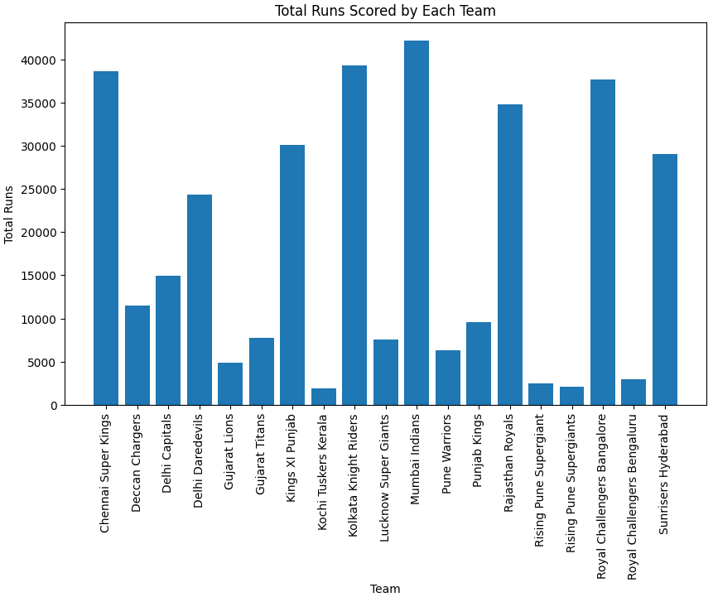
Q.1 Total Runs Scored by Each Team
Mumbai Indians have scored the highest total runs in IPL followed by Royal Challengers Bangalore and Kings XI Punjab.

Slide 9
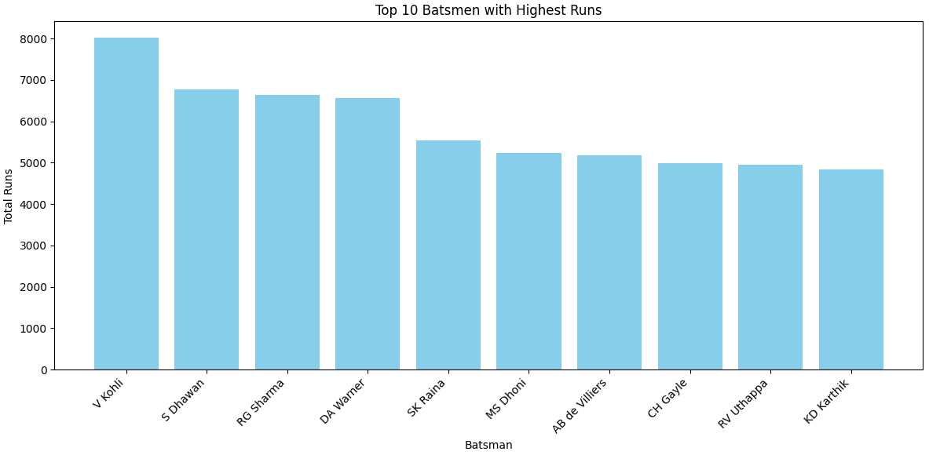
Q.2 Top 10 Batsmen with Highest Runs
Virat Kohli is the highest run-scorer in IPL followed by Shikhar Dhawan and David Warner.

Slide 10
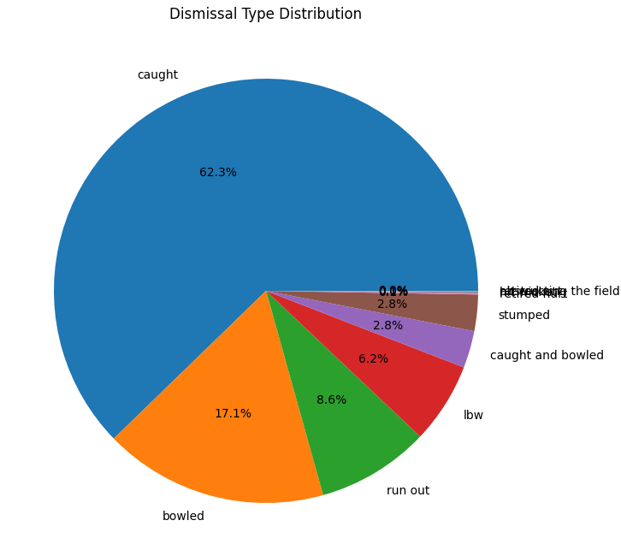
Q.3 Dismissal Type Distribution
Caught is the most common dismissal type in IPL, followed by bowled and run out.

Slide 11
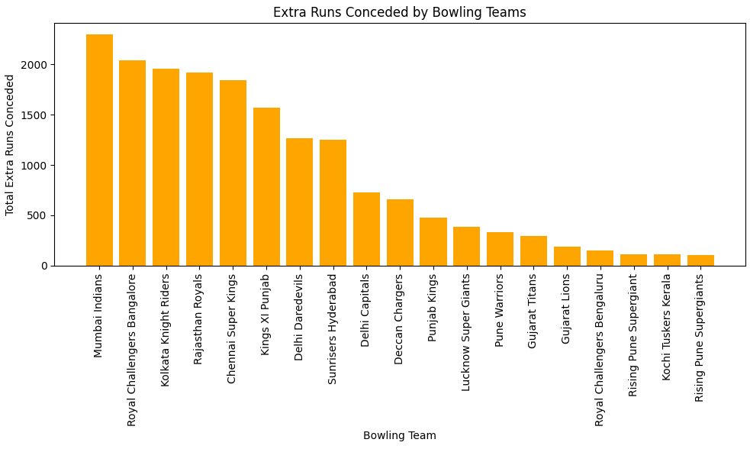
Q.4 Which bowling team has conceded the most extra runs in the IPL?
Mumbai Indians have conceded the most extra runs in the IPL.

Slide 12

Q.5 Total Runs Scored by Each Team
Mumbai Indians have scored the most runs overall in the IPL, followed by Royal Challengers Bangalore.

Slide 13
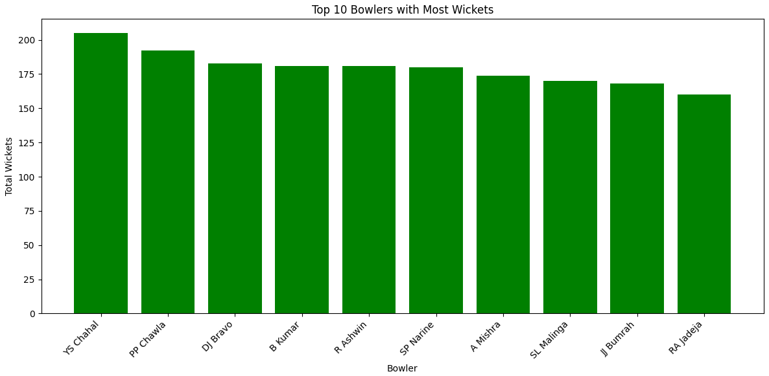
Q.6 Top 10 Bowlers with Most Wickets
Dwayne Bravo, SL Malinga, and Amit Mishra are the top wicket-takers in the IPL.

Slide 14
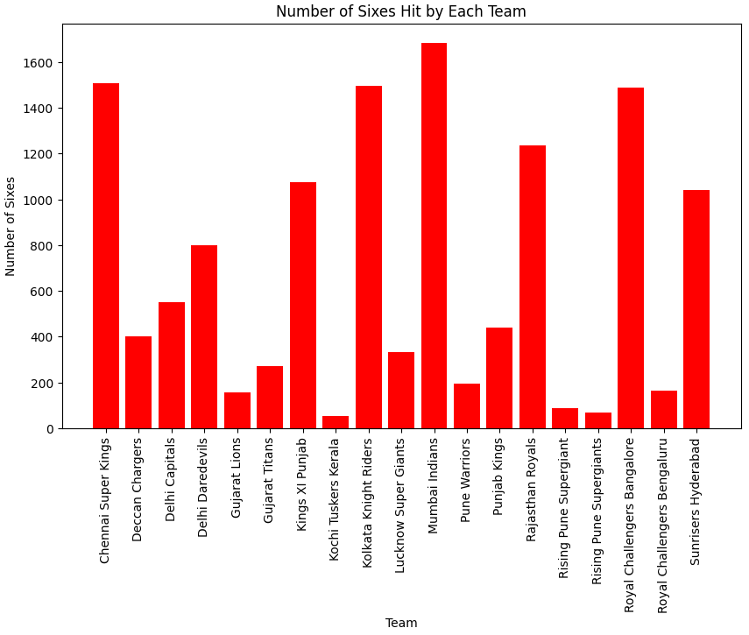
Q.7 Number of Sixes Hit by Each Team
Royal Challengers Bangalore have hit the most sixes in the IPL followed by Mumbai Indians.

Slide 15
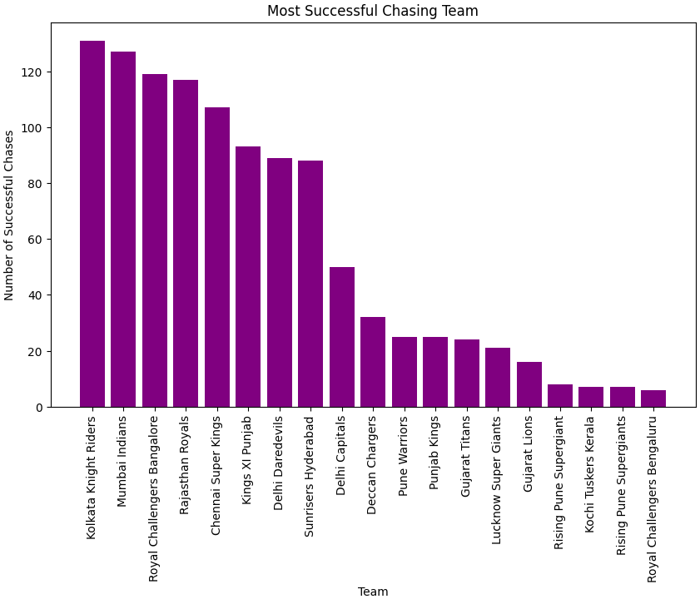
Q.8 Most Successful Chasing Team
Kolkata Knight Riders have been the most successful team while chasing targets in the IPL.

Slide 16
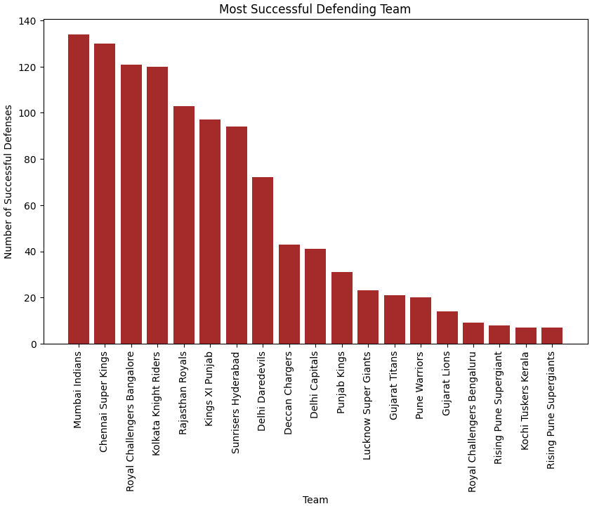
Q.9 Most Successful Defending Team
Mumbai Indians have been the most successful team while defending targets in the IPL.

Slide 17
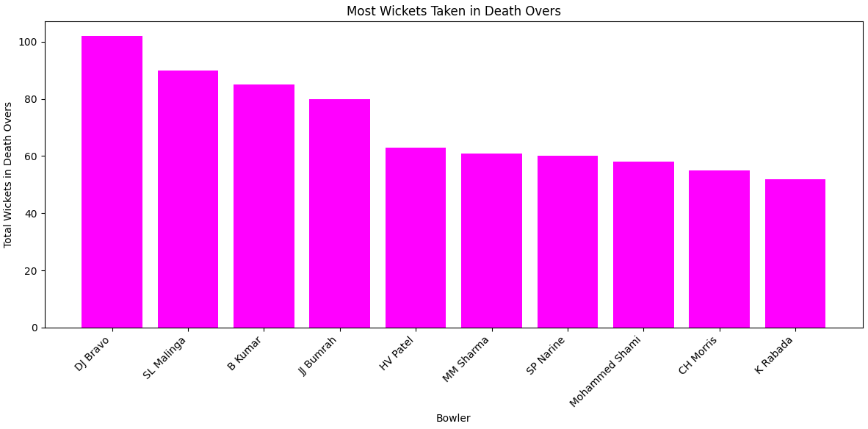
Q.10 Most Wickets Taken in Death Overs (Overs 16-20)
Dwayne Bravo, Lasith Malinga has taken the most wickets in death overs followed by Bhuvneshwar Kumar.

Slide 18
Conclusion
The Indian Premier League (IPL) dataset reveals several key insights into team and player performance. Mumbai Indians emerge as a dominant force, having scored the most runs and defended targets successfully more often than other teams. Their dominance is further highlighted by their high extra run concession, possibly indicating an aggressive bowling strategy.
In batting, Virat Kohli leads with the most runs scored, suggesting remarkable consistency throughout the tournament's history. However, other teams like Royal Challengers Bangalore demonstrate powerful hitting with more sixes. The prominence of 'caught' dismissals emphasizes the significance of aerial shots and the importance of fielding in the IPL.
Kolkata Knight Riders stand out for their success in chasing targets, indicating adeptness in high-pressure scenarios. Bowling analysis reveals the impact of Dwayne Bravo and SL Malinga, with impressive wicket tallies overall and during death overs. While Mumbai Indians and Royal Challengers Bangalore consistently score high, Kolkata Knight Riders' strength in chasing reveals tactical diversity within the league.
Ultimately, the IPL dataset illustrates a dynamic landscape where batting and bowling prowess, strategic decisions, and player performance influence outcomes. The data-driven analysis illuminates competitive aspects, contributing to a richer understanding of this electrifying cricket tournament.

Slide 19

THANK YOU

